Slide 1

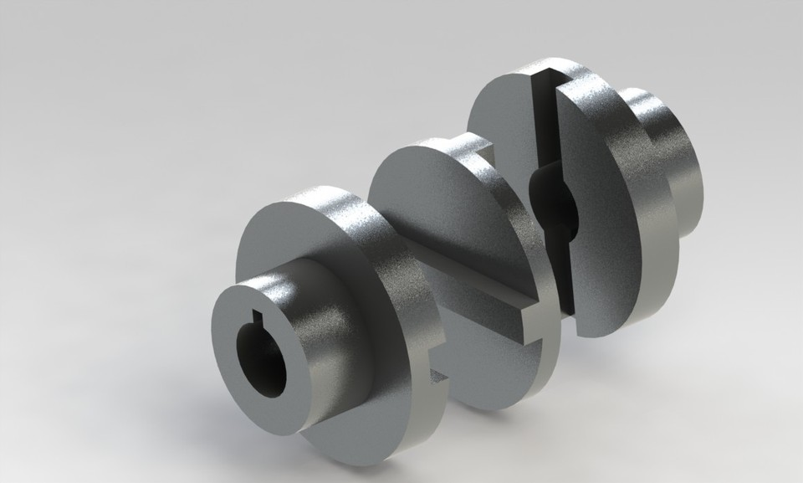
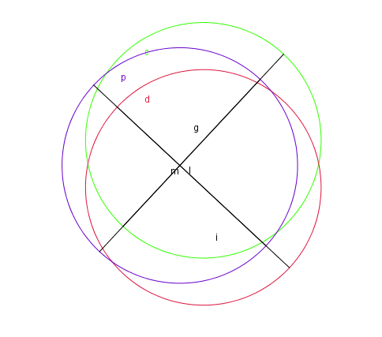
Oldham Coupling Analysis

Slide 2
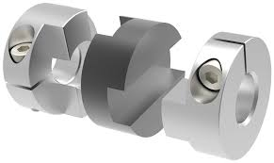
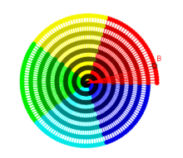
Parts Of Oldham Coupling
Flange
(Driving)
Central Piece
Flange
(Driven)

Slide 3
Representation in Geogebra
Driving Flange- Green
Central Piece- Blue
Driven Flange- Red

Slide 4

But Can we guess the movement of Central piece

Slide 5
Video For better understanding

Slide 6
Analysis
Movement of central piece is about a circle with diameter equal to offset.
In Mechanical design if
Diameter of coupling is ‘X’
Offset is ‘Y’
Then total movement in terms of area for central piece is =circle with diameter(X+Y)

